Slide 1
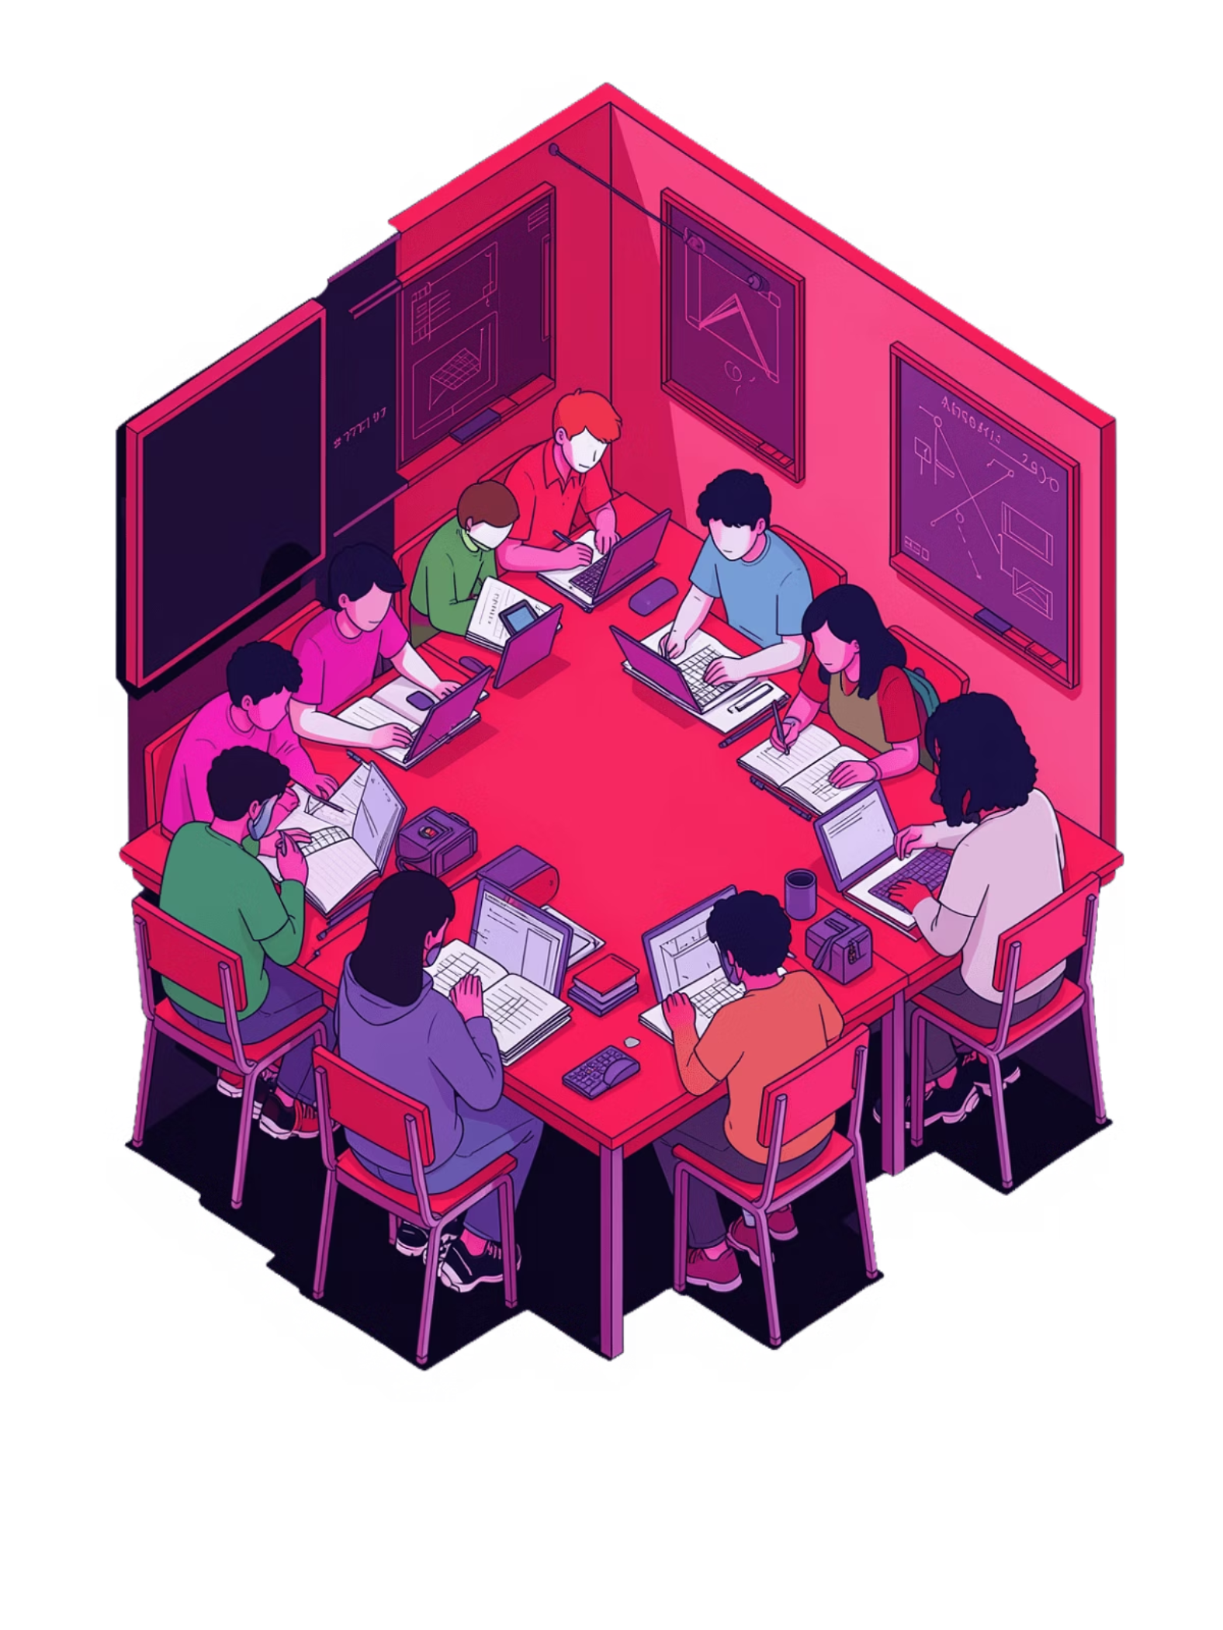
Unsupervised Learning on Student Behaviour Dataset
Clustering Analysis using Machine Learning
PYTHON
SCIKIT-LEARN
UNSUPERVISED LEARNING

Slide 2


What Are We Trying to Discover?
Project Objective
Analyse student behavioural data to group learners with similar patterns — without using any pre-existing labels. The goal is to let the data reveal its own hidden structure.
Group Similar Learners
Identify Engagement Levels
Unsupervised Approach
Cluster students based on academic and behavioural features
Surface high, medium, and low engagement segments
Discover patterns with no labelled training data

Slide 3





Dataset at a Glance
The Student Behaviour Dataset contains ~480 student records across multiple academic and behavioural dimensions.
Raised Hands
Visited Resources
Announcements View
Discussion Activity
Measures class participation and in-session engagement
Tracks how often students access study materials
Frequency of checking course announcements
Level of participation in peer discussions
Parent Involvement
Degree of parental engagement in learning

Slide 4
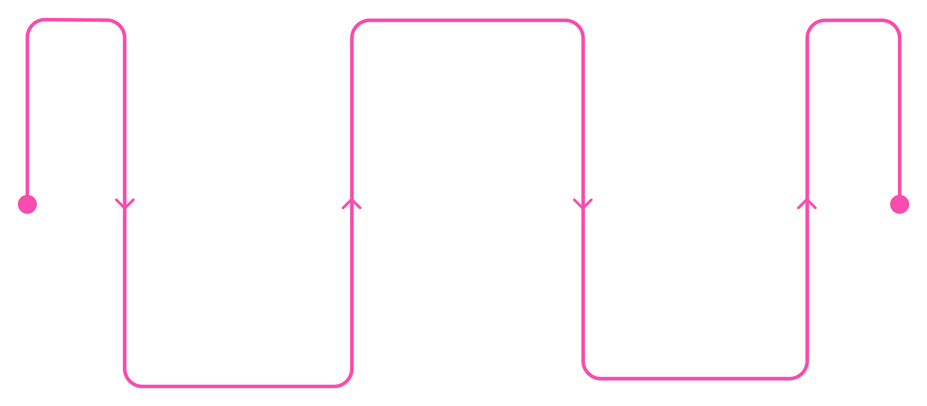
Data Preprocessing Pipeline
Select
Choose key behavioural and academic features
Encode
Scale
Label-encode categorical variables
Apply StandardScaler to normalise ranges
Why Scaling Matters
Encoding Approach
Clustering algorithms rely on distance calculations. Without scaling, features with larger numeric ranges dominate the clusters — StandardScaler ensures every feature contributes fairly.
Categorical variables like Gender and Relation were converted to numerical form using Label Encoding, making them compatible with distance-based algorithms.

Slide 5
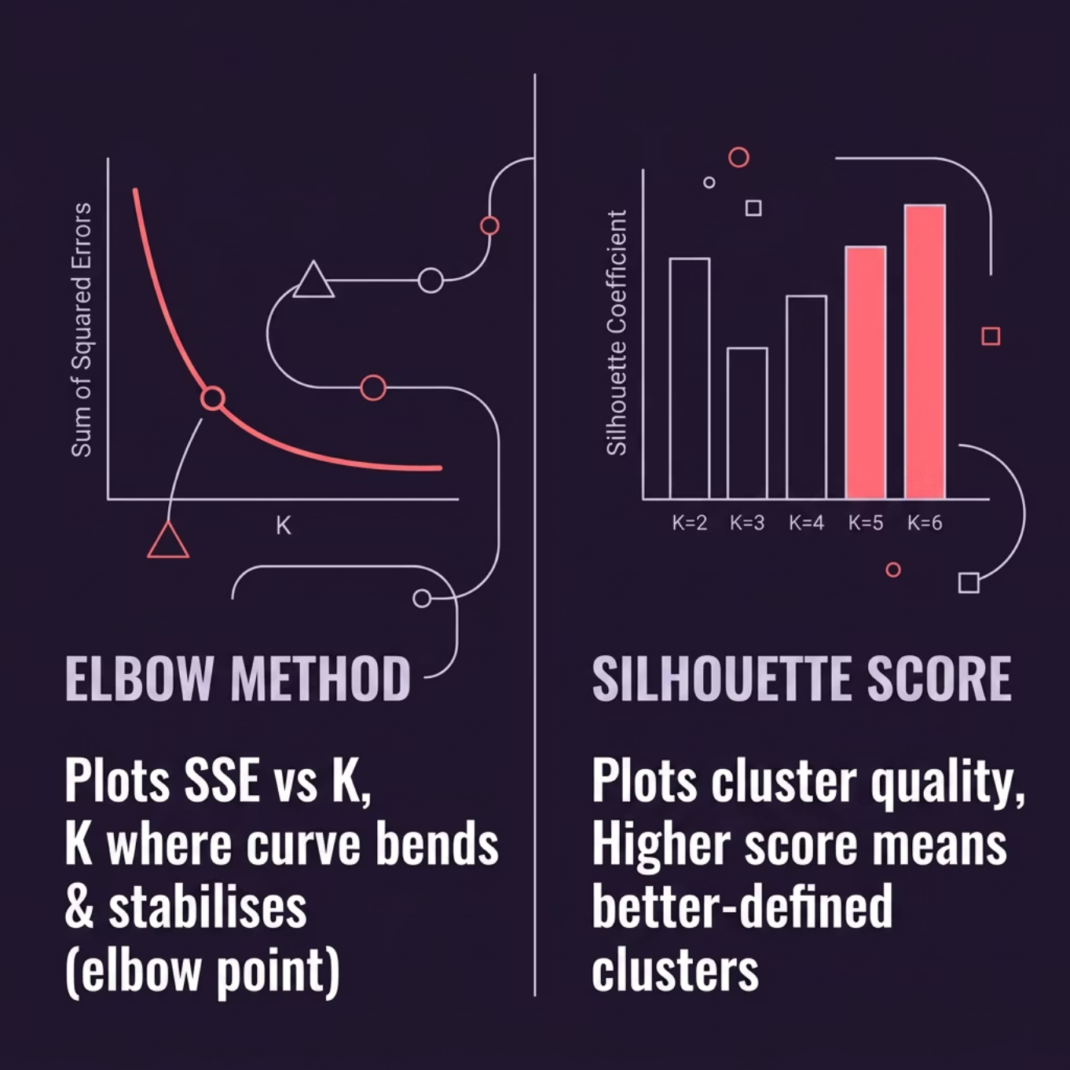


Finding the Optimal Number of Clusters
Two-Method Validation
Using both methods together provides a more reliable estimate of K than relying on either alone.
The optimal K is computed programmatically — the graphs confirm and validate the selection.
Elbow Method
Silhouette Score
Identifies where adding more clusters yields diminishing returns on inertia reduction
Quantifies how similar each point is to its own cluster vs. neighbouring clusters (range: −1 to 1)

Slide 6
Five Algorithms, One Goal
The project benchmarks five distinct clustering approaches to identify which best captures student groupings.
K-Means
1
Centroid-based, hard assignment
MiniBatch K-Means
2
Faster, scalable variant of K-Means
Agglomerative
3
Hierarchical, bottom-up merging
DBSCAN
4
Density-based, noise-aware
GMM
5
Probabilistic, soft cluster boundaries

Slide 7
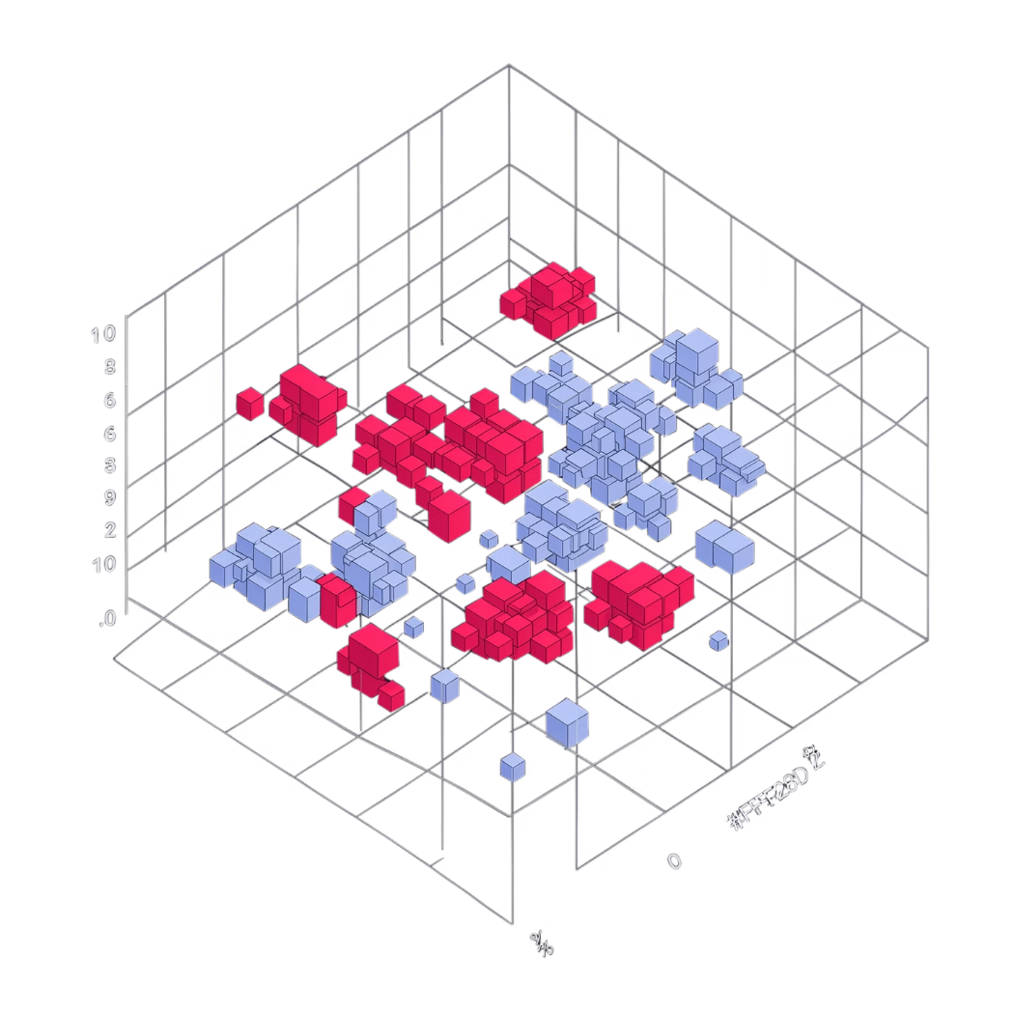



K-Means: The Best Performing Model
How K-Means Works
K-Means iteratively assigns each data point to the nearest centroid, then recomputes centroids until cluster assignments stabilise.
Well-Separated Clusters
Highest Silhouette Score
Stable Formation
Distinct student groups emerged with minimal overlap
Outperformed all other algorithms on cluster quality
Consistent cluster assignments across multiple runs

Slide 8

Comparing All Algorithms
MiniBatch K-Means
Agglomerative
DBSCAN
GMM
Faster training on large data, but trades a slight drop in accuracy for speed. Ideal for scaling.
Produces an interpretable dendrogram hierarchy, but memory and compute costs rise sharply with data size.
Effective at detecting noise/outliers, but struggled with the varying density and shapes in this dataset.
Enables soft, probabilistic assignments, but cluster boundaries were less decisive — reducing interpretability.
Each algorithm has its strengths — context and data shape determine the best fit.

Slide 9
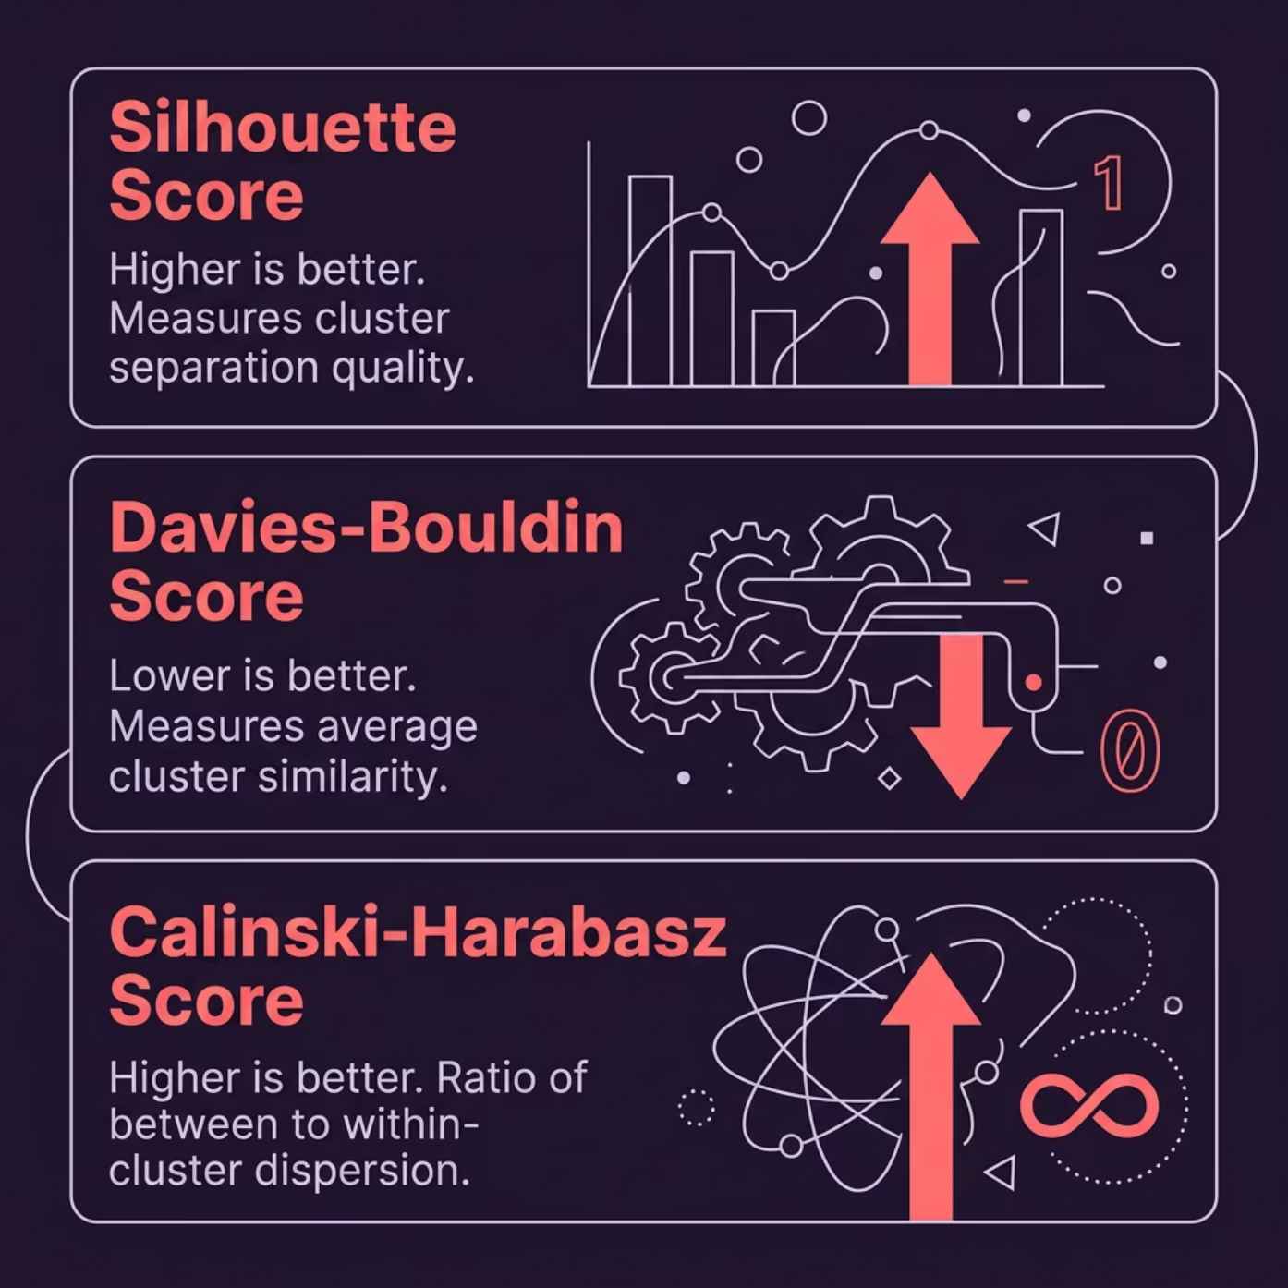

Evaluation Metrics
Primary Metric: Silhouette Score
Measures how well each point fits its assigned cluster relative to neighbouring clusters. The closer to +1, the better.
K-Means ✅
Others
Highest silhouette score — best separation
Lower scores — less cohesive groupings

Slide 10

Results & Key Insights
Best Algorithm
Optimal Clusters
K-Means delivered the clearest, most stable student clusters with the highest silhouette score across all tested methods.
The elbow and silhouette methods converged on an optimal K value — computed programmatically from the dataset.
Key Takeaway
Unsupervised learning successfully revealed distinct engagement tiers among students — without a single label.

